Slide 1
REUSE

Slide 2
REUSE
조원 소개

Slide 3
PPT PRESENTATION
Enjoy your stylish business and campus life with BIZCAM
2023년 1월
80%
60%
40%
2024년 1월
40%
CONTENTS A
컨텐츠에 대한 내용을 적어요
Enjoy your stylish business and campus life with BIZCAM
CONTENTS A
컨텐츠에 대한 내용을 적어요
Enjoy your stylish business and campus life with BIZCAM

Slide 4
PPT PRESENTATION
Enjoy your stylish business and campus life with BIZCAM
2023년 1월
80%
60%
40%
2024년 1월
40%
CONTENTS A
컨텐츠에 대한 내용을 적어요
Enjoy your stylish business and campus life with BIZCAM
CONTENTS A
컨텐츠에 대한 내용을 적어요
Enjoy your stylish business and campus life with BIZCAM

Slide 5
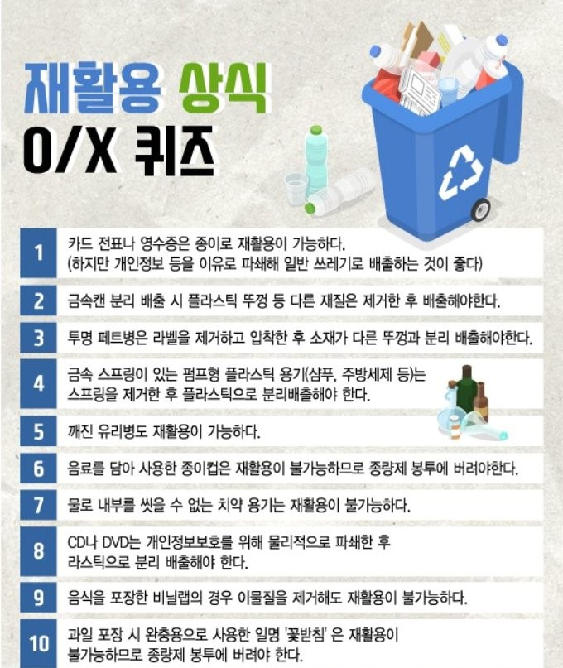
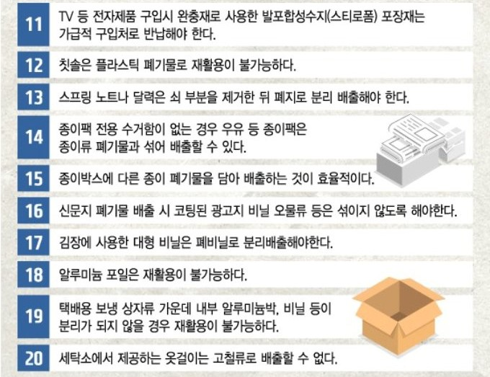
PPT PRESENTATION
Enjoy your stylish business and campus life with BIZCAM
Notes:
번호에 OX 표시 효과

Slide 6
PPT PRESENTATION
Enjoy your stylish business and campus life with BIZCAM

Slide 7
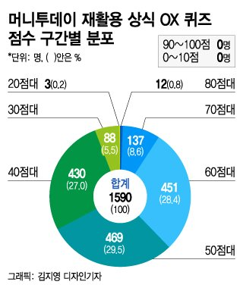
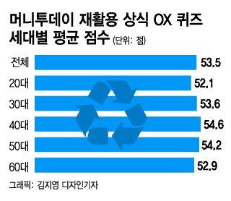
PPT PRESENTATION
Enjoy your stylish business and campus life with BIZCAM

Slide 8
PPT PRESENTATION
Enjoy your stylish business and campus life with BIZCAM
그래서 분리 수거랑 에너지가 무슨 상관임?

Slide 9
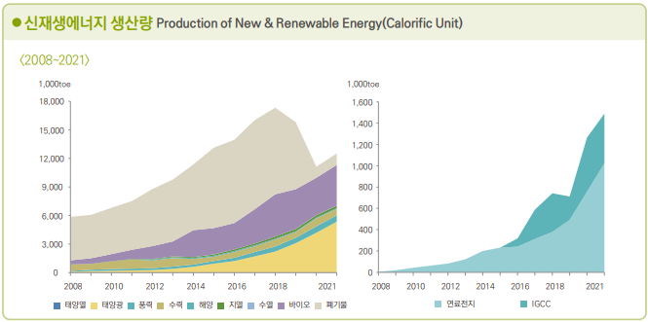
PPT PRESENTATION
Enjoy your stylish business and campus life with BIZCAM

Slide 10
PPT PRESENTATION
Enjoy your stylish business and campus life with BIZCAM
01
CONTENTS
02
CONTENTS
03
CONTENTS
CONTENTS
컨텐츠에 대한 내용을 적어요
Enjoy your stylish business and campus life with BIZCAM
CONTENTS
컨텐츠에 대한 내용을 적어요
Enjoy your stylish business and campus life with BIZCAM
CONTENTS
컨텐츠에 대한 내용을 적어요
Enjoy your stylish business and campus life with BIZCAM

Slide 11
PPT PRESENTATION
Enjoy your stylish business and campus life with BIZCAM
조사대상 총 인원
10,234,893명
CONTENTS
35% (4,256,644)
www.pptbizcam.co.kr
CONTENTS
65% (4,256,644)
www.pptbizcam.co.kr
컨텐츠에 대한 내용을 적어요
PowerPoint is a computer program created by Microsoft Office
Enjoy your stylish business and campus life with BIZCAM

Slide 12
분리수거 이렇게!!
Enjoy your stylish business and campus life with BIZCAM
환경과학과 201234567 조땡

Slide 13
PPT PRESENTATION
Enjoy your stylish business and campus life with BIZCAM

Slide 14
PPT PRESENTATION
Enjoy your stylish business and campus life with BIZCAM

Slide 15
PPT PRESENTATION
Enjoy your stylish business and campus life with BIZCAM

